Slide 1
design rules to support usability

Slide 2
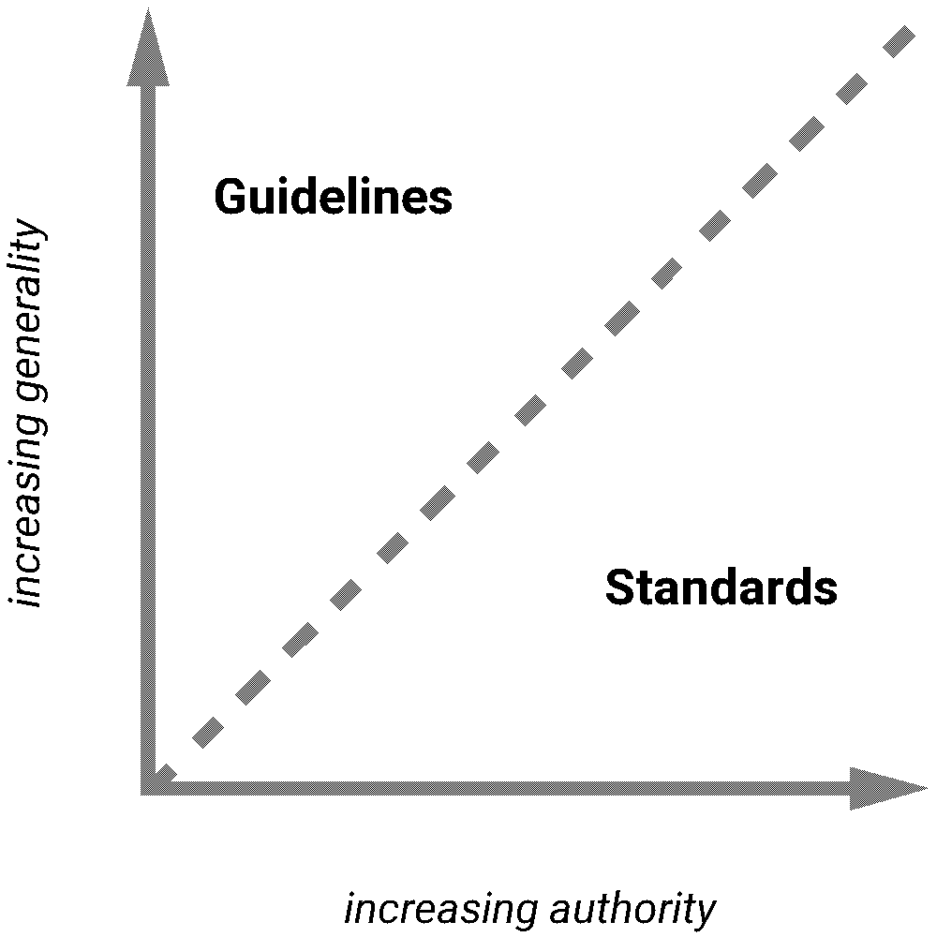
design rules
Rules a designer can follow – increase the usability of the eventual software product.
Rules can be classified based on two dimensions :
Authority (an indication whether a rule must be followed/only suggested )
Generality (an indication whether a rule can be applied to many situations /limited applications)
Types of design rules
Principles
Standards
Guidelines
increasing generality
increasing authority

Slide 3
design rules
Standards
(Are usually set by national or international bodies to ensure compliance with a set of design rules by a large community)
specific design rules
high authority
Low generality
limited application
Both h/w and s/w
increasing generality
increasing authority

Slide 4
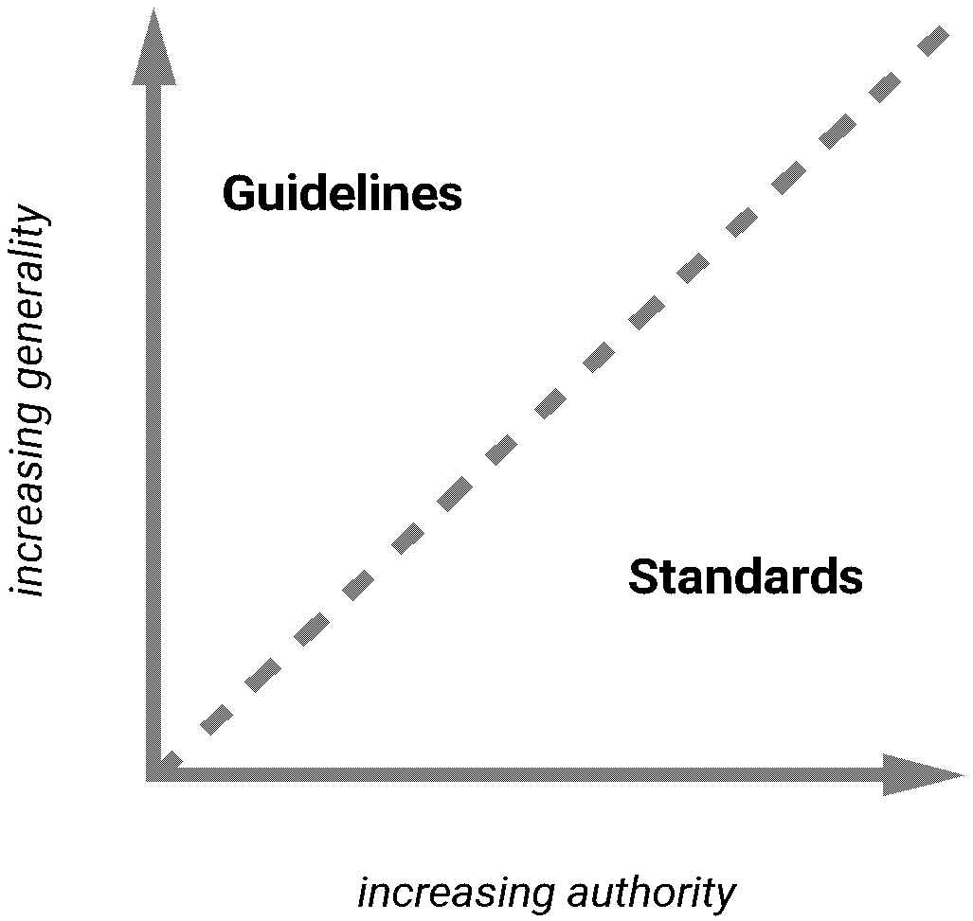
design rules
Guidelines
(Are less abstract and more technology oriented and more general in nature )
lower authority
more general application
The more abstract guideline, the more it resembles principle
increasing generality
increasing authority

Slide 5
design rules
Principles
(Are derived from knowledge of the psychological, computational and sociological aspects of the problem domain and are largely independent of the technology and based on deeper understanding of the human element )
abstract design rules
low authority
high generality
more general application
increasing generality
increasing authority

Slide 6
Principles to support usability
Learnability
The ease with which new users can begin effective interaction and achieve maximal performance
Flexibility
The multiplicity of ways the user and system exchange information
Robustness
The level of support provided to the user in determining successful achievement and assessment of goal-directed behaviour

Slide 7
Principles to support usability
Principles affecting learnability
Predictability , Synthesizability , Familiarity, Generalizability, Consistency
Principles affecting Flexibility
Dialogue initiative, Multi-threading , Task Migratability, Substitutivity, Customizability
Principles affecting Robustness
Observability, Recovervability, Responsiveness, Task conformance

Slide 8
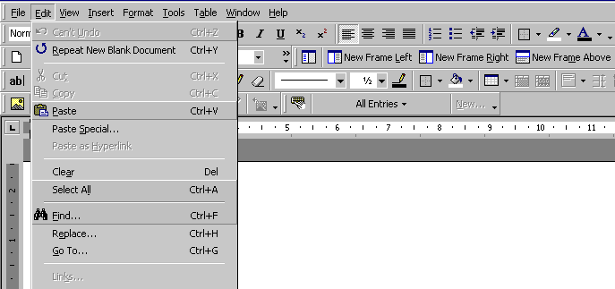
Principles of learnability
Predictability -- User should be able to determine effect of future actions based on past interaction history [no surprises – ☺]
Based on principle of determinism and operation visibility (recognition vs. recall)

Slide 9
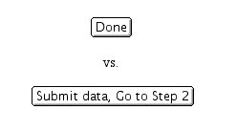
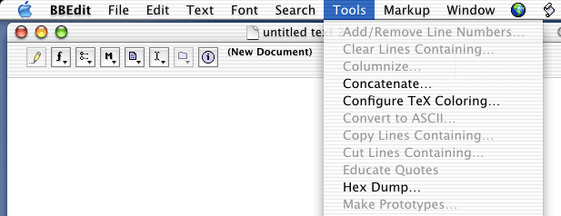
Predictability
What will this action do?
Operation visibility - can see avail actions
grayed menu items
menus vs. command shell
Notes:
Will the action complete the application?
Seeing grayed menu items lets the user know what is provided but not currently available – gives hints about the state

Slide 10
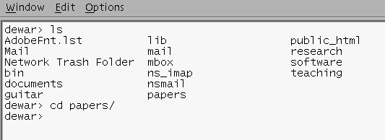
Principles of learnability
Synthesizability-- User should be able to assess the effect of past actions
Change should be visible
(principle -- immediate vs. eventual honesty )
Word processor ( global search and replace function)

Slide 11
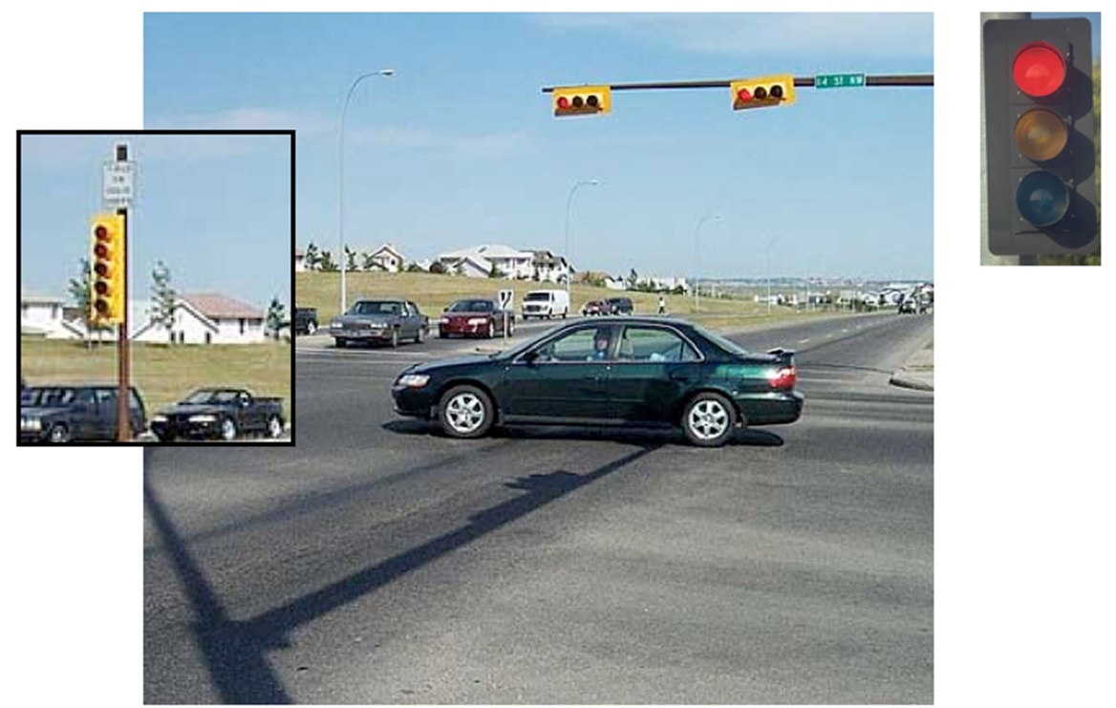
Principles of learnability
Familiarity – User’s knowledge and experience in other real- world or computer based domains should be applied when interacting with a new system (door open, close)
Use of natural language syntax
(Principal– guessability)

Slide 12
Principles of learnability
Generalizability - Extending user’s specific interaction knowledge to new situations Like cut, copy, paste
Drawing circles ---- drawing ellipses
(principal—generalization)

Slide 13
Principles of learnability
Consistency – User’s experience should remain consistent
Challenge (and danger): consistency not self-contained
consistency within screens
consistency within applications
consistency within desktop layouts
….
Examples:
short-cut keys for similar action; same placement for recurrent menu options
Always place the Quit command as the last item in the leftmost menu
Always place the Home command on the leftmost top corner

Slide 14
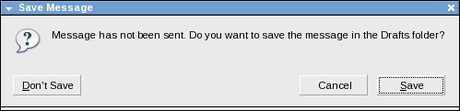
Principles of flexibility
Dialogue initiative -- User should be able to abandon, suspend or resume tasks at any point
Freedom from system imposed constraints on input dialogue
Principle -- system vs. user pre-emptiveness (maximize the user’s ability to pre-empt the system and minimize the system’s ability to pre-empt the user) (master-slave)

Slide 15
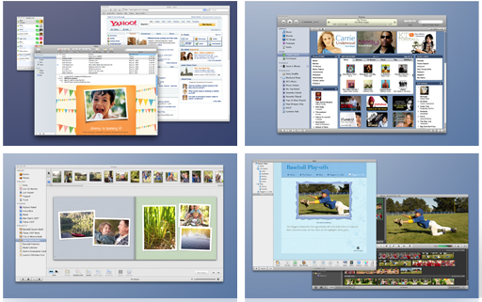
Principles of flexibility
Multithreading -- Ability of system to support user interaction for more than one task at a time
Window system support a multi-threaded dialogue, each window can represent a diff. Task (multi-modality- graphics, text, and audio output with speech, text and touch input)

Slide 16
Principles of flexibility
Task Migratability – User should be able to Automate routine tasks,
People get bored doing routine tasks and stop concentrating (Yerkes-Dodson Law)
Ability to pass control for the execution of a given task so that it becomes either internalized by the user or the system or shared between them (passing responsibility for task execution between user and system) (spell check)
People are better at | Machines are better at
Improvising and using flexible procedures | Following procedures repeatedly and precisely
Exercising judgment | Following orders
Selective information recall | Total information recall

Slide 17
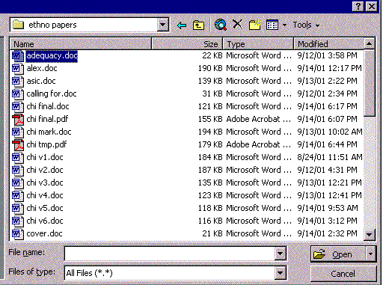
Principles of flexibility
Substitutivity – User should not be forced to refer to objects by name if they can point to them
Equal opportunity

Slide 18
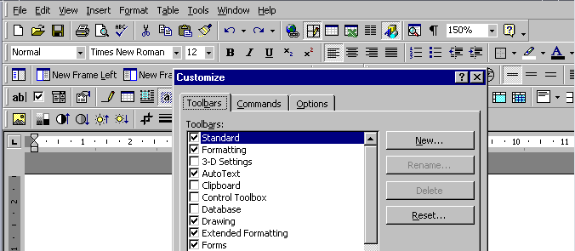
Principles of flexibility
Customizability -- Modifiability of the user interface by user or system
Customization of the user I/f by the user -- (adaptability)
Automatic customization of the user I/f by the system -- (adaptivity)

Slide 19
Principles of robustness
Observability -- User should be able to evaluate the internal state of the system from its perceivable representation
Browsability; defaults; operation visibility
Where , What of navigation:
Where am I? — immediate honesty w.r.t system state
Where am I going? — operation predictability
Where have I been? — synthesisability
What can I do now? — predictability

Slide 20
Principles of robustness
Recoverability – User should be able to take corrective action once an error has been recognized
Supported by reducing scope for making errors
avoid free-form input wherever possible and validate input immediately, allowing correction
… and ability of user to understand errors
error messages should be concise, informative, specific, constructive
Poor :: Error 404: document not found
Better :: The requested URL http://www.foobar.com/bar.html
could not be found

Slide 21
Principles of robustness
Responsiveness – User should get instant response
Short durations and instantaneous response times are desirable (pull-down menus are expected to pop-up instantaneously as soon as mouse button is pressed)
Task conformance -- Degree to which system supports the user's tasks
Identify core tasks; provide a command for each
Task completeness

Slide 22
Principles, Heuristics and Golden Rules
Different collections e.g.:
Norman’s 7 Principles
Nielsen’s 10 Heuristics (used in Heuristic Evaluation)
Shneiderman’s 8 Golden Rules:

Slide 23
Shneiderman’s 8 Golden Rules
1. Strive for consistency
2. Enable frequent users to use shortcuts
3. Offer informative feedback
4. Design dialogs to yield closure
5. Offer error prevention and simple error handling
6. Permit easy reversal of actions
7. Support internal locus of control
8. Reduce short-term memory load

Slide 24
Shneiderman’s 8 Golden Rules
Strive for consistency
Use Consistent color, layout, capitalization, fonts, and so on throughout
Use Consistent sequences of actions in similar situations;
Use identical terminology in prompts, menus, and help screens

Slide 25
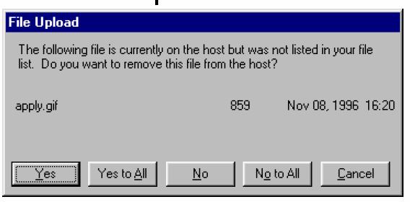
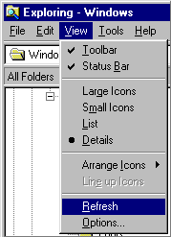
Shneiderman’s 8 Golden Rules
Enable frequent users to use shortcuts
Shortcuts should be easy to learn (keyboard accelerators, command abbreviations, bookmarks, history)

Slide 26


Shneiderman’s 8 Golden Rules
Offer informative feedback for every user action
Keep user informed of system state:
-- Cursor change, Selection highlight, Status bar
Don’t overdo it…
Response time:
<0.1 s: seems instantaneous
0.1 – 1 s: user notices, but no feedback is needed
1-5 s: display busy cursor
>1-5 s: display progress bar

Slide 27

Shneiderman’s 8 Golden Rules
Design dialogs to yield closure
Sequences of actions should be organized into groups with a beginning, middle, and end.
The informative feedback at the completion of a group of actions gives the operators the satisfaction of accomplishment, a sense of relief, the signal to drop contingency plans and options from their minds
It is also an indication that the way is clear to prepare for the next group of actions.
Think of computer as theatre!
Computer screen as stage, enact the script!!
Think of interface in terms of
Narrative flow - beginning, middle, end
Actors/Agents - who saved your file? Who gave you the error message?
Stage with actors carrying out an action

Slide 28

Shneiderman’s 8 Golden Rules
5. Offer error prevention and simple error handling
Selection is less error-prone than typing ….But don’t overdo it…

Slide 29
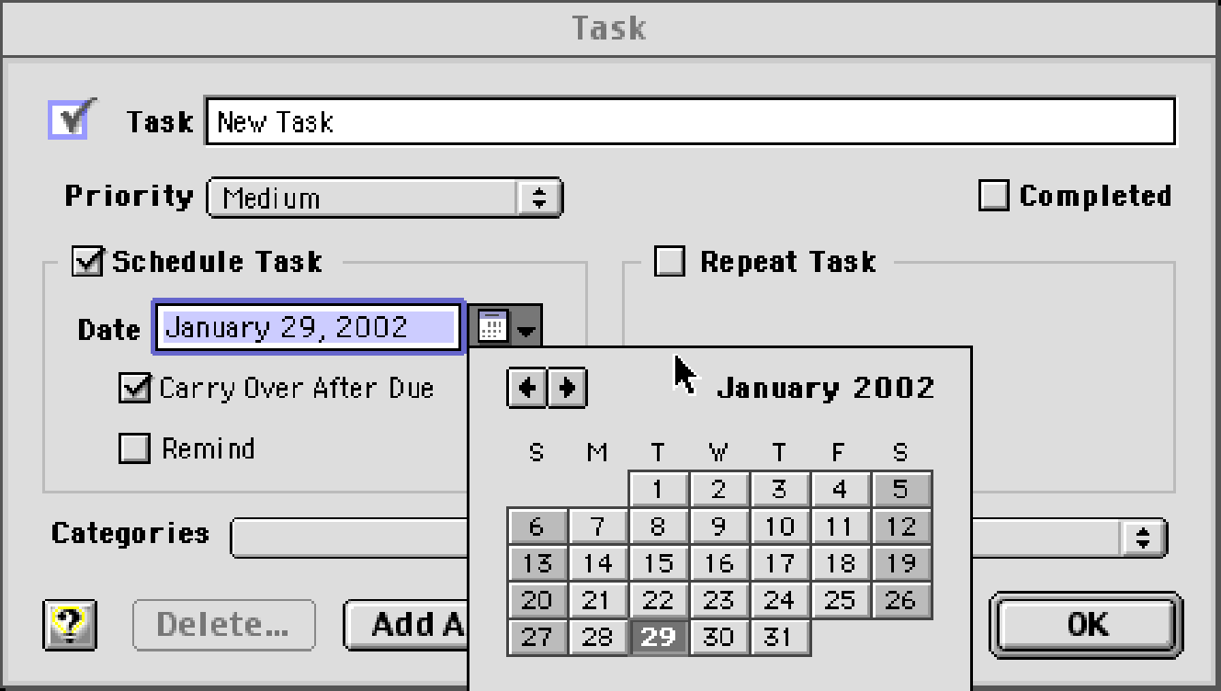
Shneiderman’s 8 Golden Rules
Offer error prevention and simple error handling
1. Disable illegal commands (gray-out)
2. Keep dangerous commands away from common ones

Slide 30
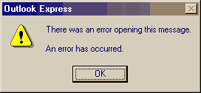
Shneiderman’s 8 Golden Rules
Offer error prevention and simple error handling
3. Explicit : clearly indicate that something has gone wrong.
When users make mistakes and get no feedback, they're completely lost.
for example, Email offers several situations where explicit indication would be useful.
4. Human-readable language : instead of obscure codes or abbreviations such as "an error of type 2 has occurred."
5. Polite :phrasing that doesn't blame users or imply that they are either stupid or doing something wrong, as in "illegal command.“

Slide 31
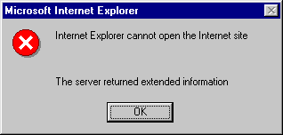
Shneiderman’s 8 Golden Rules
Offer error prevention and simple error handling
6. Precise : descriptions of exact problems, rather than vague generalities such as "syntax error."
7. Constructive advice : on how to fix the problem. For example, instead of saying "out of stock," your error message should either tell users when the product will be available or provide a way for users to ask to be notified when the product is restocked.

Slide 32
Shneiderman’s 8 Golden Rules
Permit easy reversal of actions
Relieves anxiety
Encourages exploration of unfamiliar options
Dimensions of reversibility
a single action,
a data entry,
a complete group of actions

Slide 33
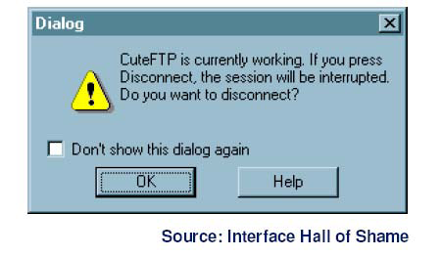
Shneiderman’s 8 Golden Rules
Support internal locus of control
The system should be in control of the user, which should respond to his actions.
Long operations should be cancelable
All dialogs should have a cancel button

Slide 34
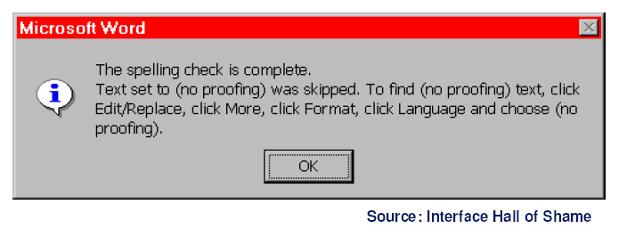
Shneiderman’s 8 Golden Rules
Reduce short-term memory load
Keep displays simple
Consolidate multiple-pages display
Provide time for learning action sequences
Rely on recognition, not recall
Use menus, not command languages, Use generic commands when possible (Open, Save, Copy, Paste)
All needed information should be visible

Slide 35
Shneiderman’s 8 Golden Rules
1. Strive for consistency
2. Enable frequent users to use shortcuts
3. Offer informative feedback
4. Design dialogs to yield closure
5. Offer error prevention and simple error handling
6. Permit easy reversal of actions
7. Support internal locus of control
8. Reduce short-term memory load

Slide 36
Ten Usability Heuristics by Jakob Nielsen
Visibility of system status
The system should always keep users informed about what is going on, through appropriate feedback within reasonable time.
Match between system and the real world
The system should speak the users' language, with words, phrases and concepts familiar to the user, rather than system-oriented terms.
Follow real-world conventions, making information appear in a natural and logical order.
User control and freedom
Users often choose system functions by mistake and will need a clearly marked "emergency exit" to leave the unwanted state without having to go through an extended dialogue.
Support undo and redo.
Consistency and standards
Users should not have to wonder whether different words, situations, or actions mean the same thing. Follow platform conventions.

Slide 37
Ten Usability Heuristics by Jakob Nielsen
Error prevention
Always careful design is better than good error messages, which prevents a problem from occurring in the first place.
Recognition rather than recall
Make objects, actions, and options visible. The user should not have to remember information from one part of the dialogue to another.
Instructions for use of the system should be visible or easily retrievable whenever appropriate.
Flexibility and efficiency of use
Allow users to tailor frequent actions.
Accelerators -- unseen by the novice user -- may often speed up the interaction for the expert user such that the system can cater to both inexperienced and experienced users.

Slide 38
Ten Usability Heuristics by Jakob Nielsen
Aesthetic and minimalist design
Dialogues should not contain information which is irrelevant or rarely needed.
Less is more.
Help users recognize, diagnose, and recover from errors
Error messages should be expressed in plain language (no codes), precisely indicate the problem, and constructively suggest a solution.
Help and documentation
Even though it is better if the system can be used without documentation, it may be necessary to provide help and documentation.
Any such information should be easy to search, focused on the user's task, list concrete steps to be carried out, and not be too large.

Slide 39
Standards
set by national or international bodies to ensure compliance by a large community of designers
standards require sound underlying theory from psychology and cognitive science and are less formed, still evolving and not very easy to interpret in the language of software design
hardware standards more common than software high authority and low level of detail
ISO 9241 defines -- ISO 9241 is a multi-part standard from the International Organization for Standardization (ISO) covering ergonomics of human-computer interaction. It is managed by the ISO Technical Committee
UK Ministry of Defence has published an Interim Defence Standard 00 -25 Human Factors for designers of Equipment – Introduction, Body size, Body strength and Stamina, workplace design, stresses and hazards, vision and lighting, visual displays, auditory information, voice communication, controls, design for maintainability, systems

Slide 40
Guidelines
more suggestive and general
many textbooks and reports full of guidelines
abstract guidelines (principles) applicable during early life cycle activities
detailed guidelines (style guides) applicable during later life cycle activities
The basic categories of the Smith and Mosier guidelines are
Data Entry
Data display
Sequence control
User Guidance
Data transmission
Data protection

Slide 41
design rules
Design rules are used to apply the theory in practice
A set of design rules may conflict with each other, strict adherence to them is impossible
The theory underlying the separate design rules can help the designer understand the trade-off for the design
Design rules – most effective – if adopted in the earliest stages of the life cycle (requirement spec, architectural design)
A set of design might be appropriate for one particular h/w platform and may be inappropriate for other platform. (color/monochrome screens, two-three button mouse)

Slide 42


Observe carefully the two design alternatives below. Which design scheme is better? Justify your response.

